Slide 1
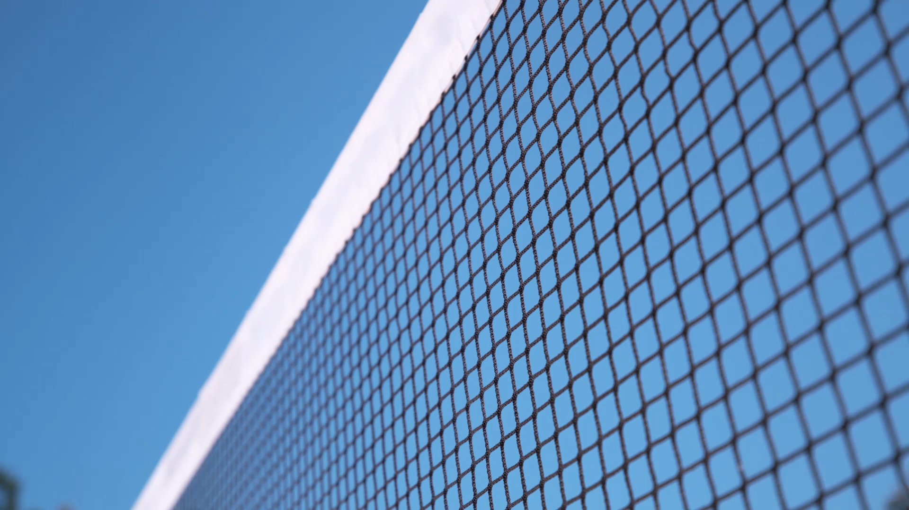
VOLLEYBALL 101
PHYSICAL EDUCATION

Slide 2
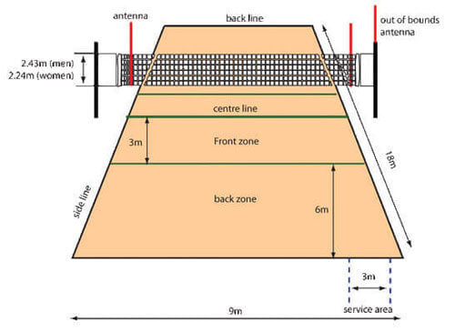
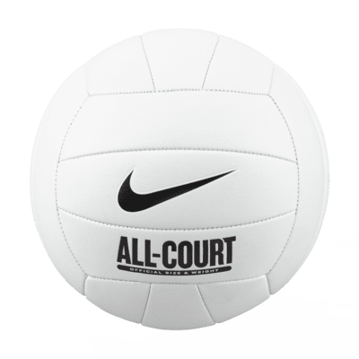
THE COURT DEMINSIONS
THE OFFICIAL BALL

Slide 3
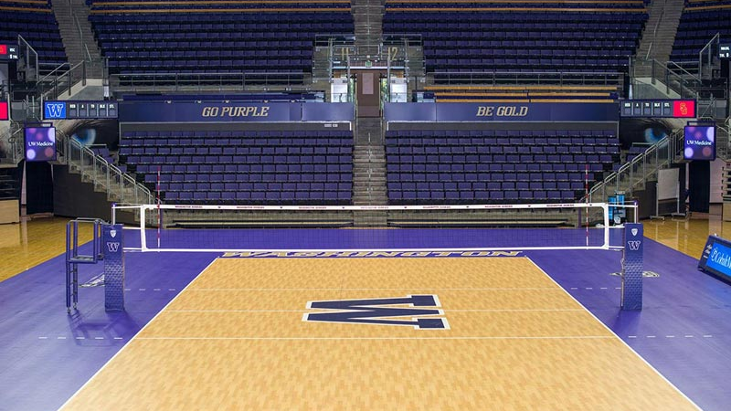

Slide 4
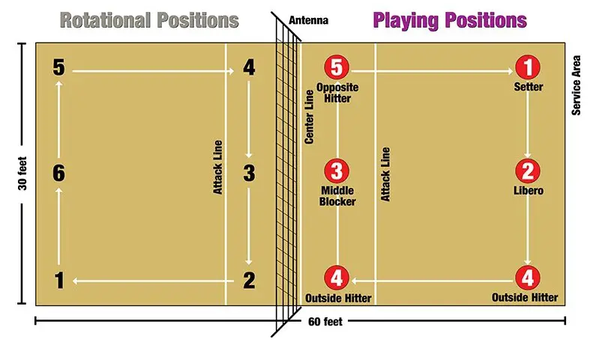
←The rearmost, roaming defensive player in volleyball; back-row defensive specialist

Slide 5

VOCABULARY PRETEST

Slide 6
VOCAB PRESTEST
Set:
A. A way to start the game
B. A quick offensive play near the net
C. A two-handed overhead pass to a teammate for an attack
2. Spike:
A. A powerful offensive hit over the net
B. A quick offensive play near the net
C. A type of serve with a high arc
3. Serve:
A quick play near the net
B. A defensive move to block an opponent's attack
C. The act of starting each point with a hit from behind the baseline
4.Dig:
A. A quick set to confuse the opponents
B. A defensive move to keep the ball off the ground after an attack
C. A type of serve with a lot of spin
5. Rotation:
A. The movement of players to different positions on the court
B. A powerful spike over the net
C. The act of serving the ball
6. Block:
A. A serve that hits the net and goes over
B. A quick offensive play near the net
C. The action of preventing the ball from crossing the net

Slide 7


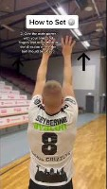
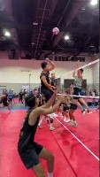
HAND PLACEMENT
EXPLAINATION
EXECUTION
HOW TO SET A VOLLEYBALL

Slide 8
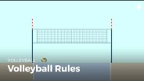

Slide 9
VIDEO QUESTIONS
1. The ball cannot touch the net during its passage.
A. True
B. False
2.How many sets are played?
A.1
B.2
C.3
D.4
3.How many points do you play to?
A.21
B.22
C.23
D.25
4.When can a team score a point:
A. When the ball hits the ground on the opponent's side of the court
B. When a team is unable to return the ball
C. When a team commits a foul
D. All of the Above
5.Each game begins with a serve hit with the hand.
A. True
B. False
6. How many touches is each team entitled to once the ball is in play before sending it back?
A.1
B.2
C.3
D.4
7.Can a single player touch the ball two times in a row?
A. Yes
b. No
8. If the team which served wins the point, do they keep the same server?
A. Yes
B. No
9.If the receiving team wins the point, do all the players rotate clockwise?
A. Yes
B. No

Slide 10



Slide 11
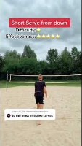
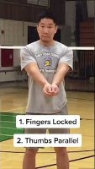
HOW TO SERVE FOR BEGINNERS
HOW TO BUMP

Slide 12
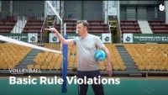

Slide 13
VIDEO QUESTIONS
1. How many types of violations you trying to avoid?
A.1
B.2
C.3
2. You want to avoid playing violations and technical violations.
A. True
B. False
3. You can hit the volleyball under the net.
A. True
B. False
4. A player is allowed to hit the ball two times in a row.
A. True
B. False
5. It is a playing violation for the ball to hit the ground on your side of the court.
True
B. False
6. You must respect rotational positions in order not to be penalized.
True
False
7. Can your foot touch the line when serving?
A. Yes
B. No
8. Can you touch the net when playing?
A. Yes
B. No
9. Can your foot touch the opponents' side of the net?
A. Yes
B. No

Slide 14
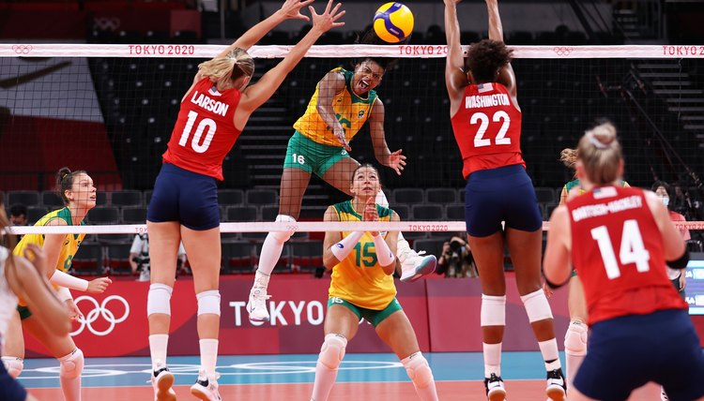

Slide 15
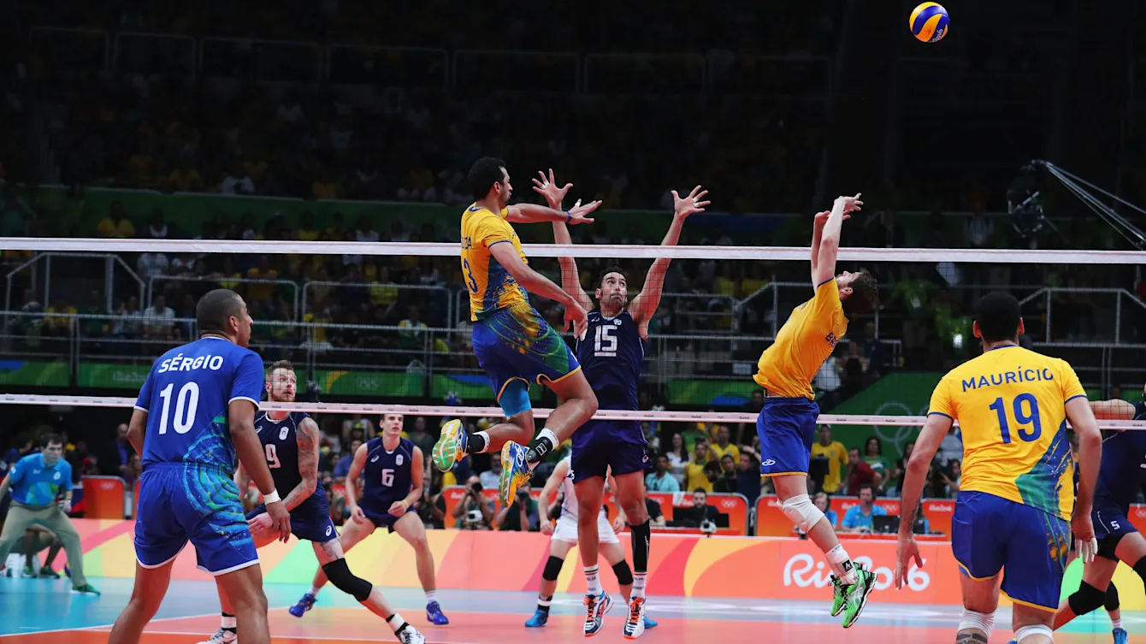

Slide 16
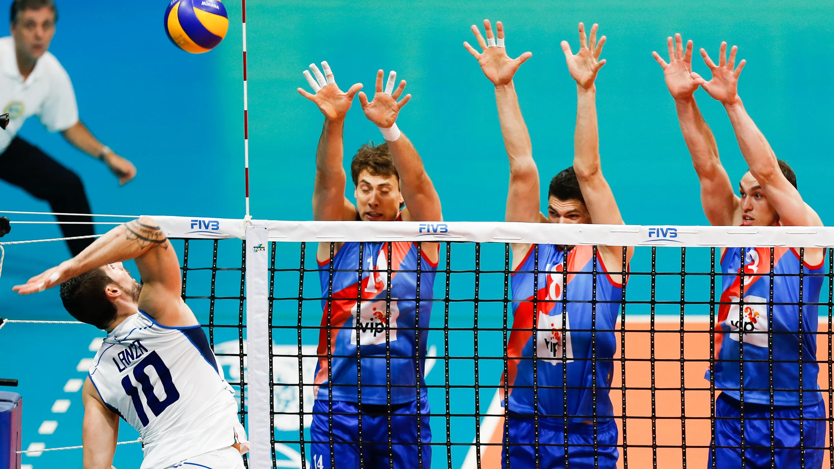

Slide 17
